Slide 1
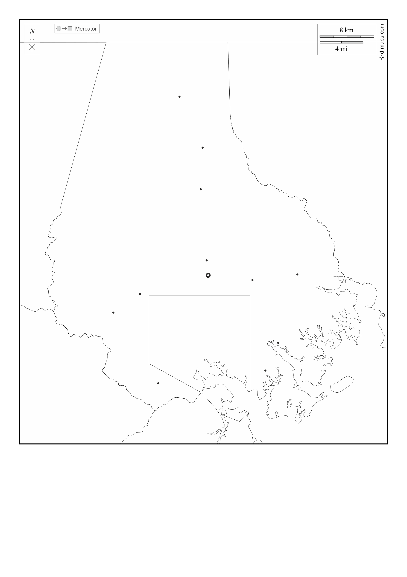
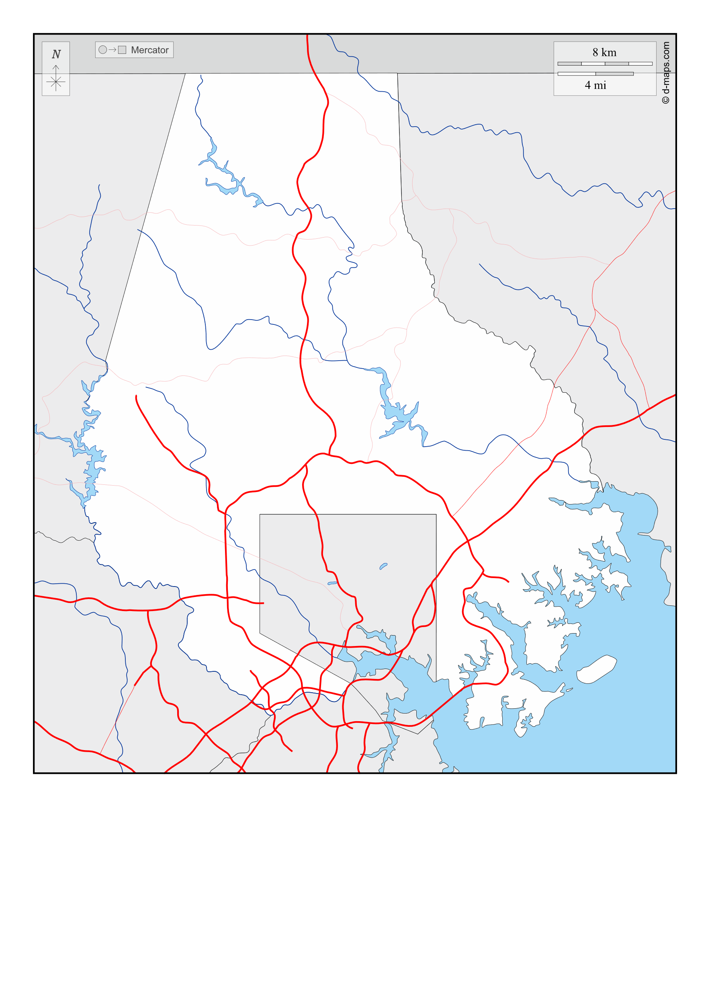





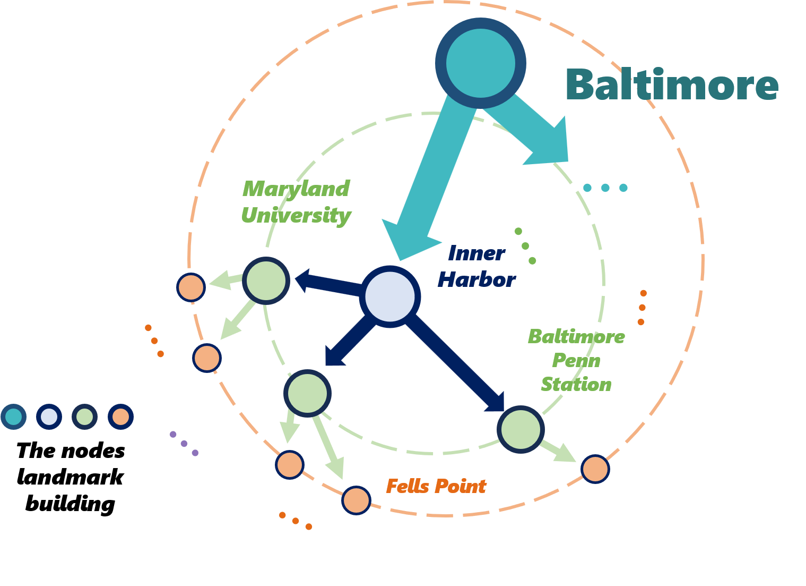
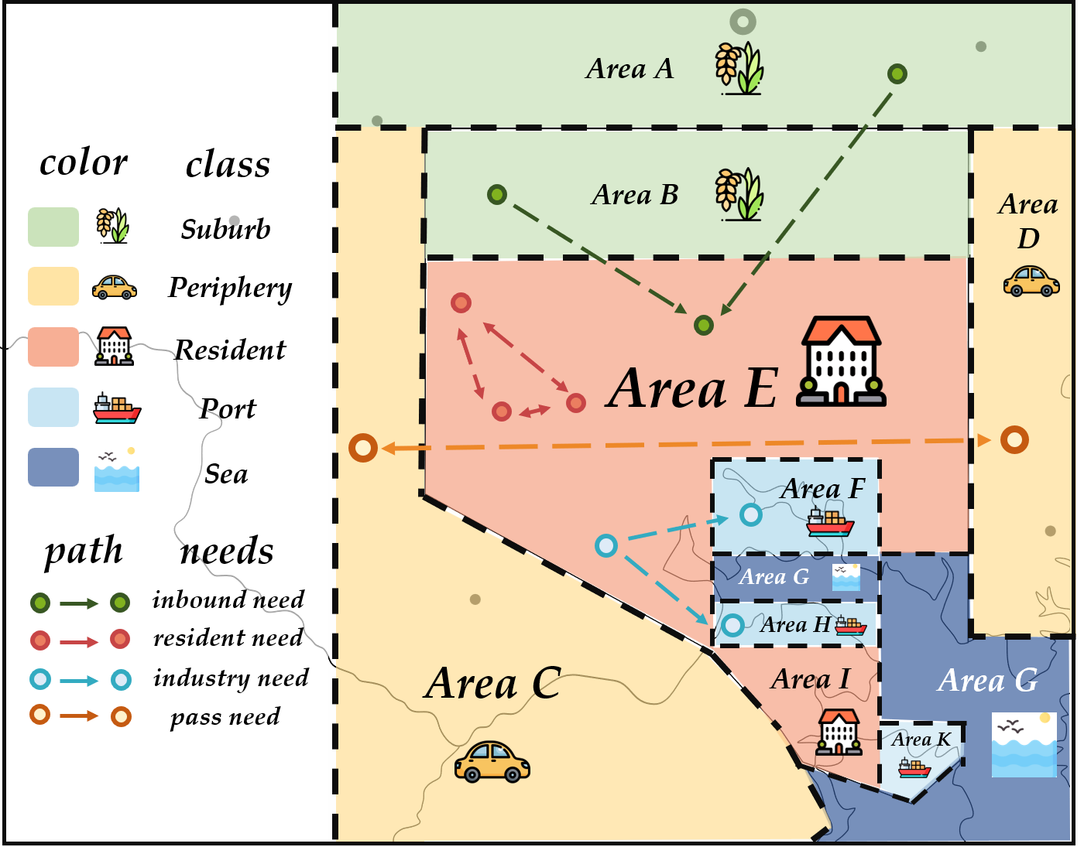
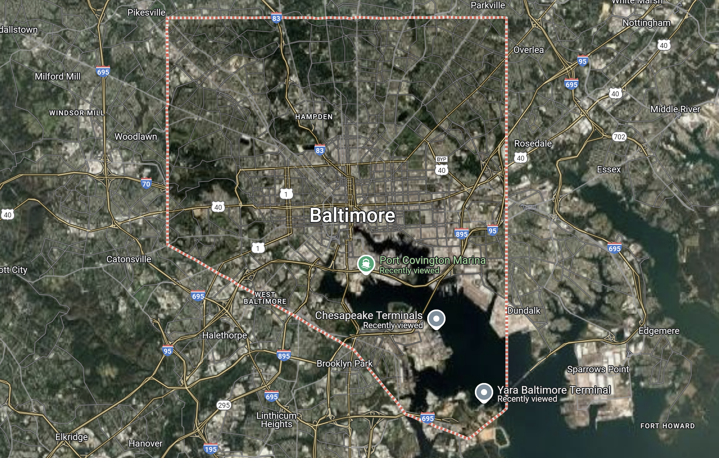
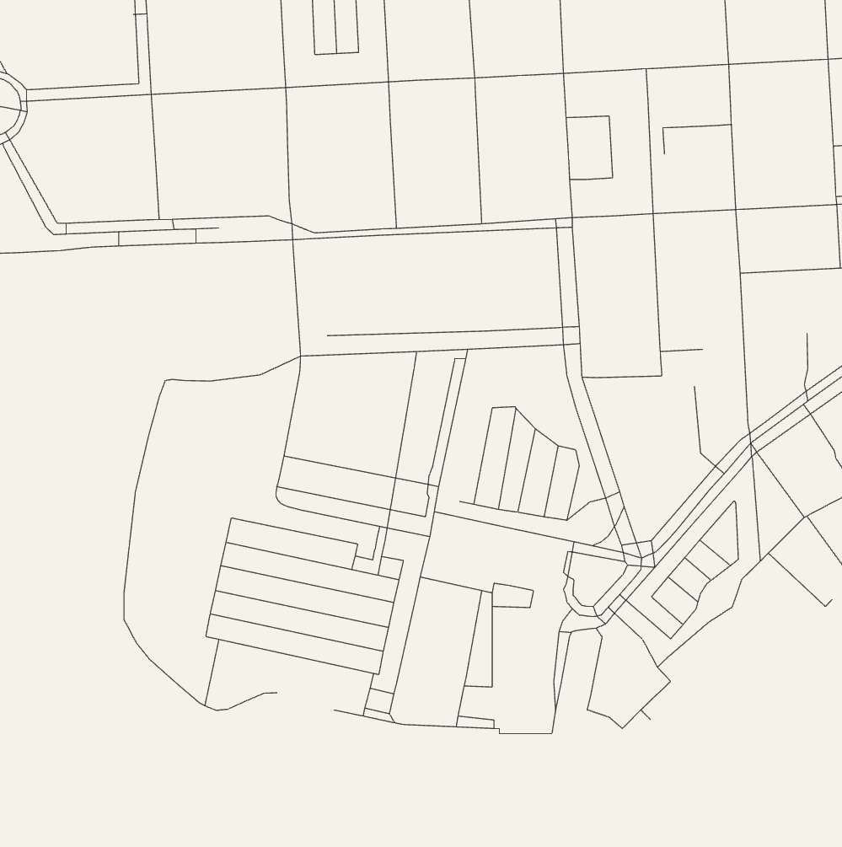
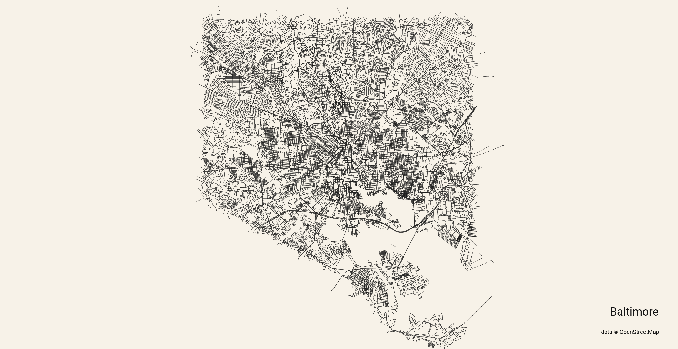

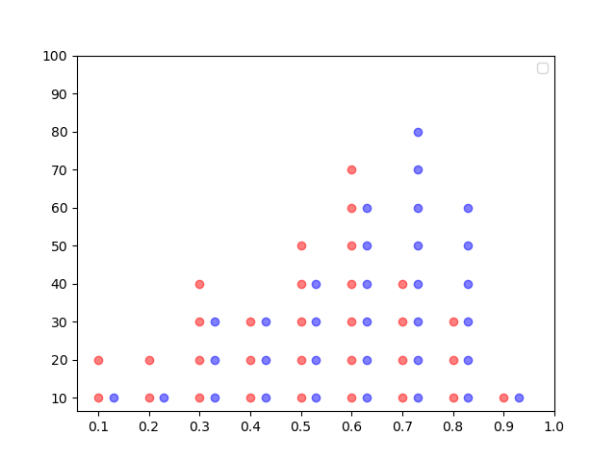
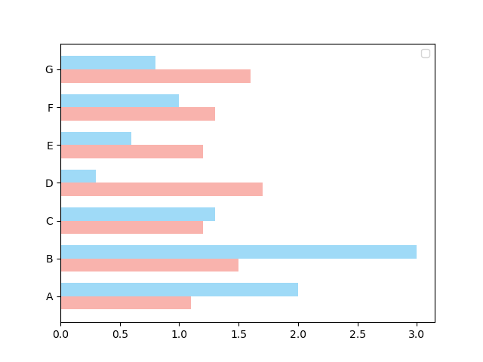



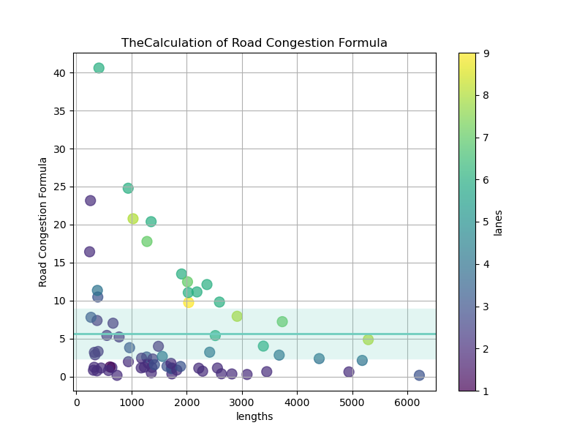
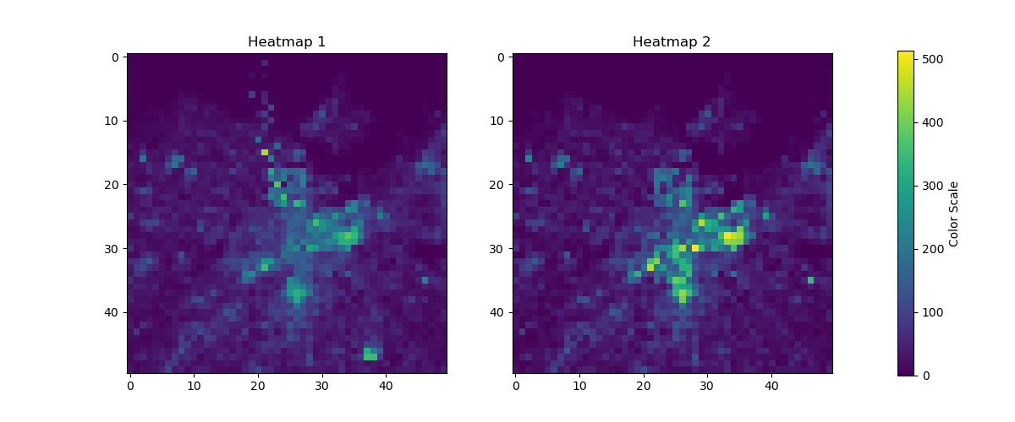
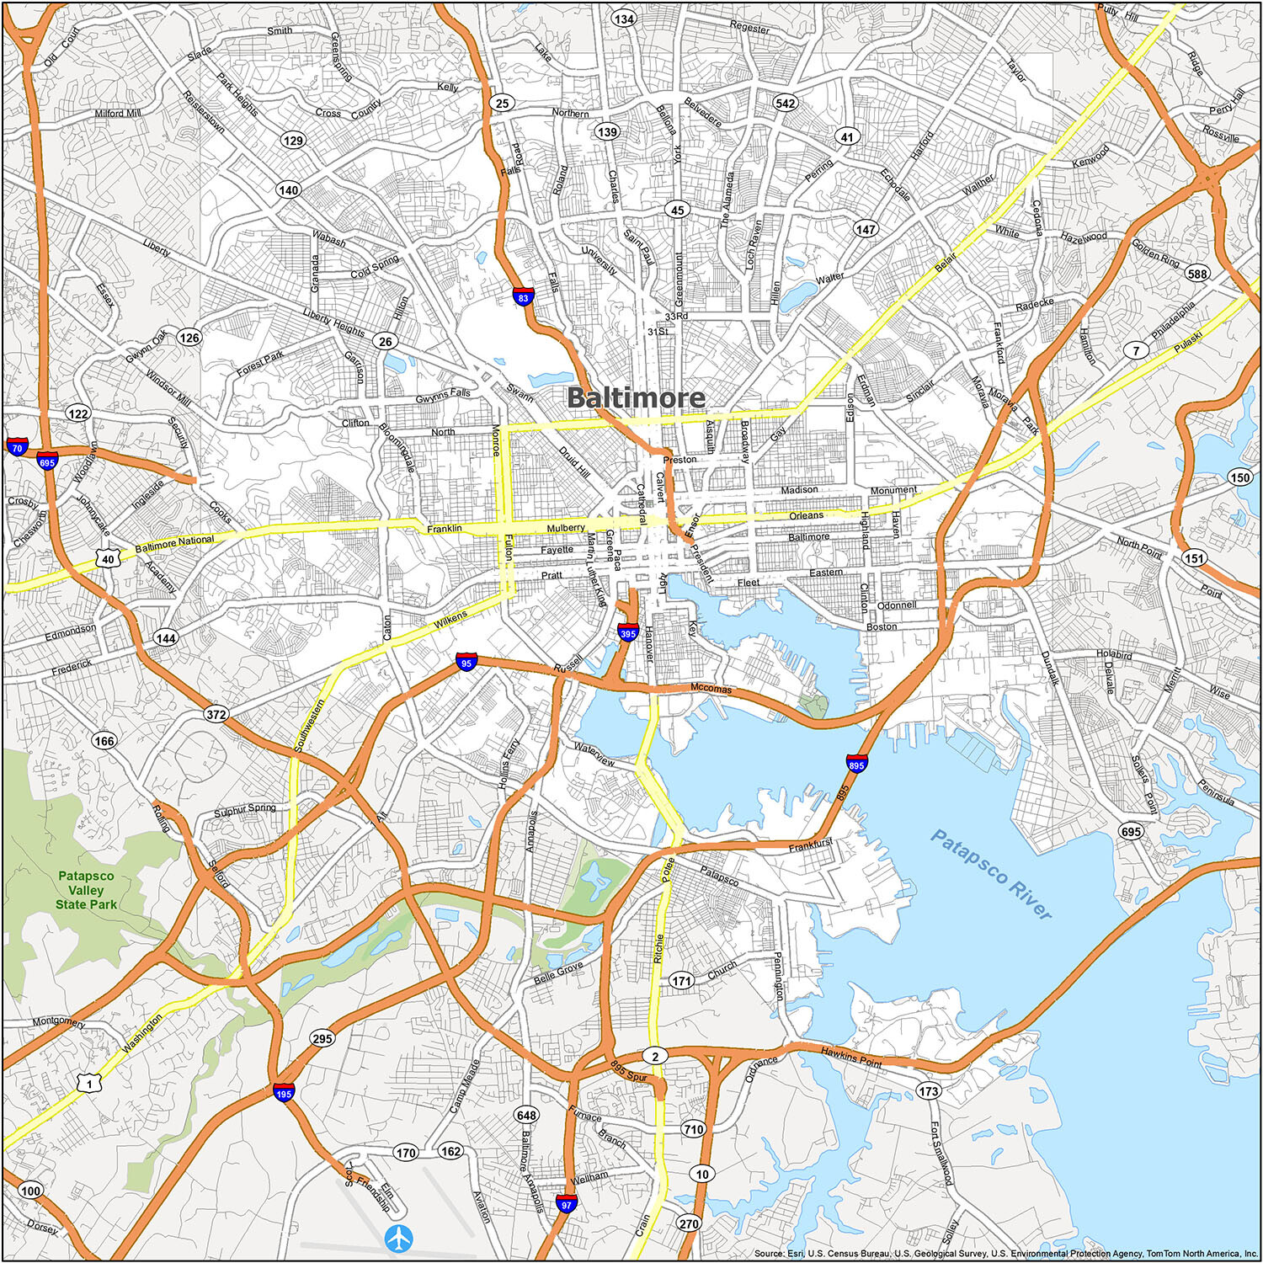

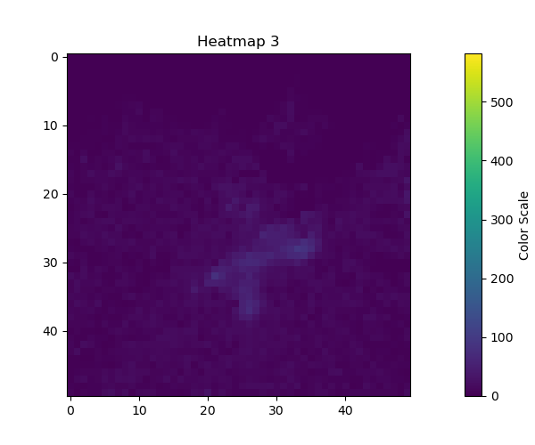
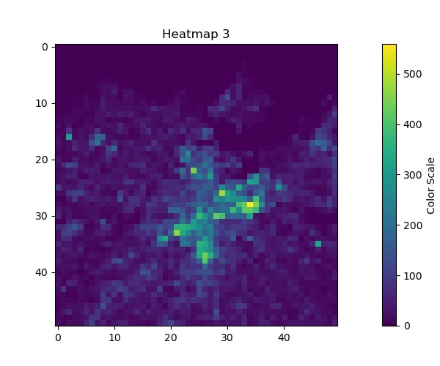
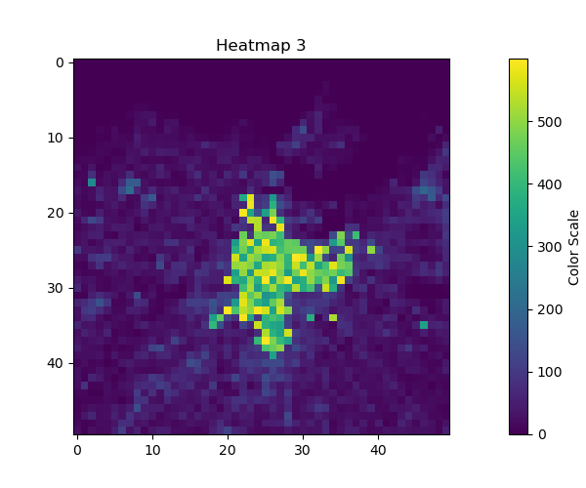
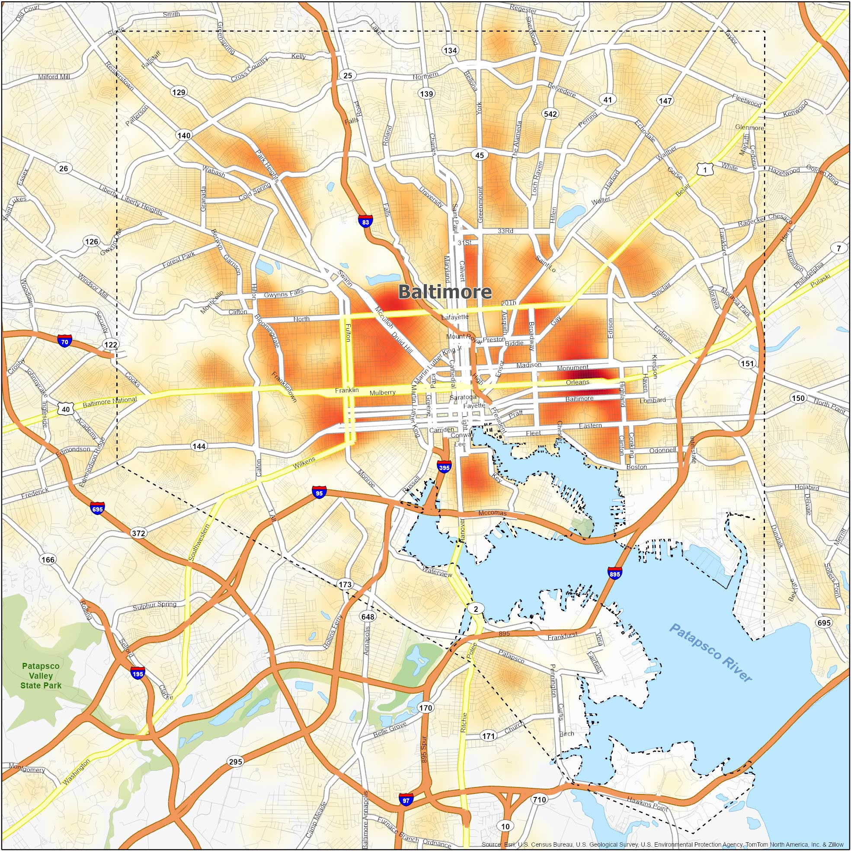
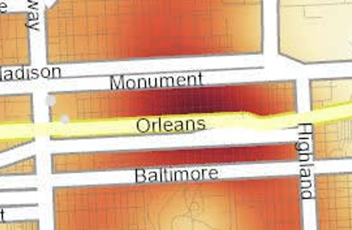
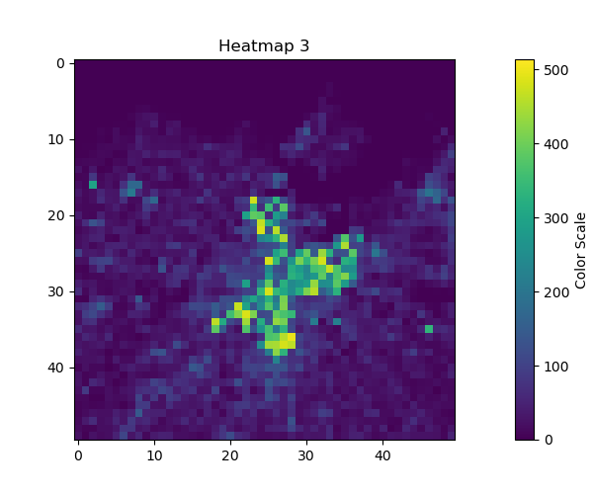
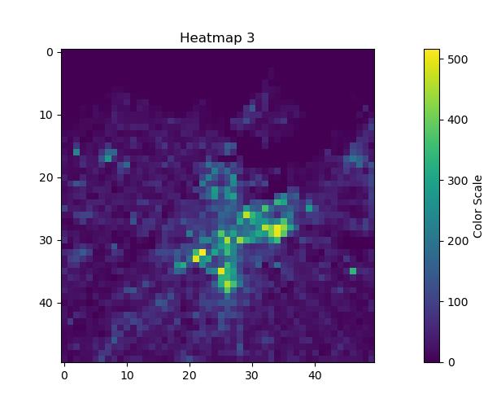
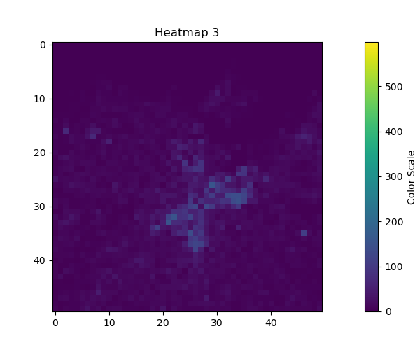
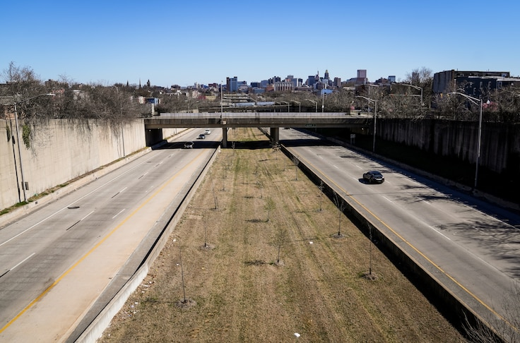
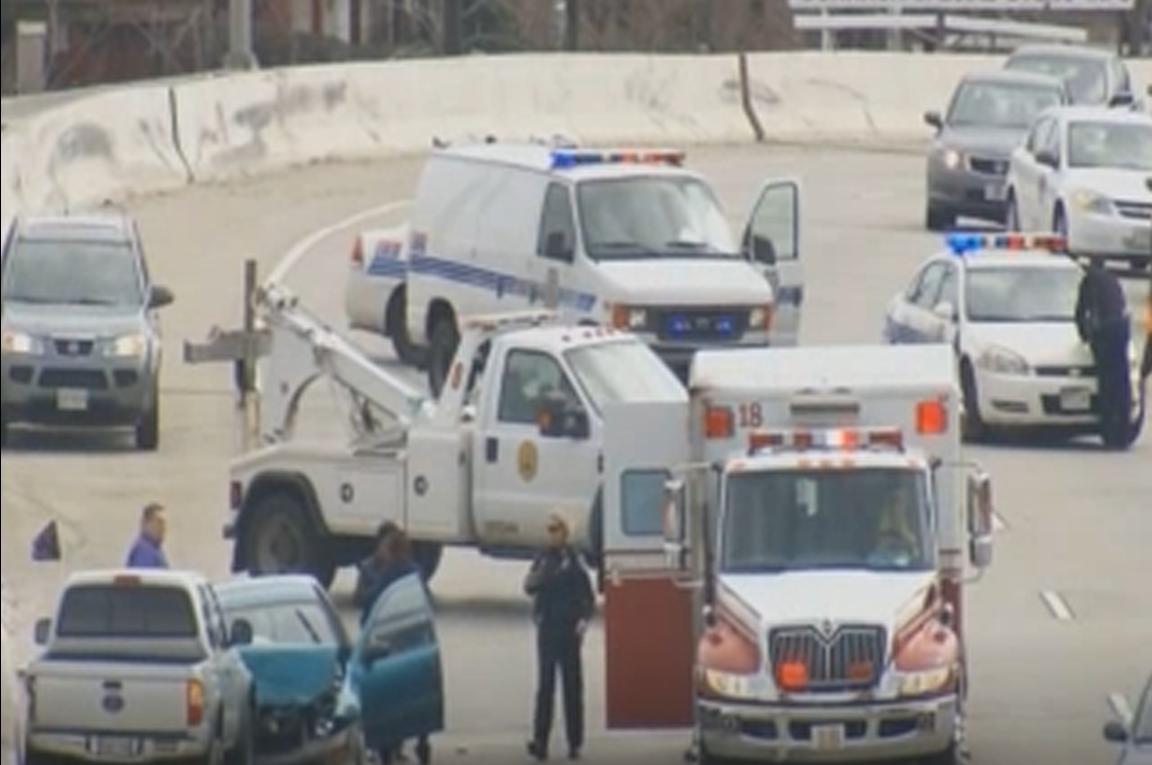
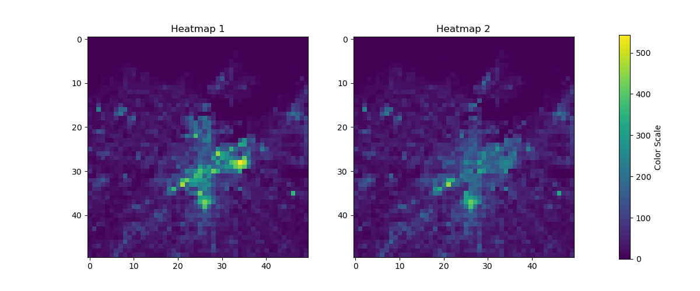
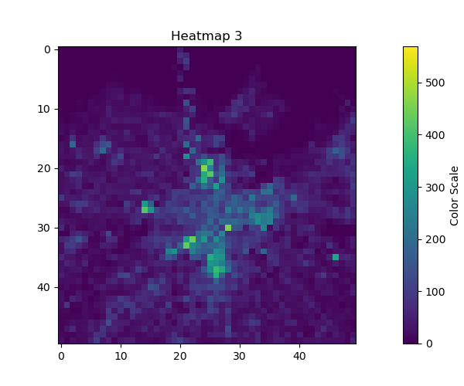
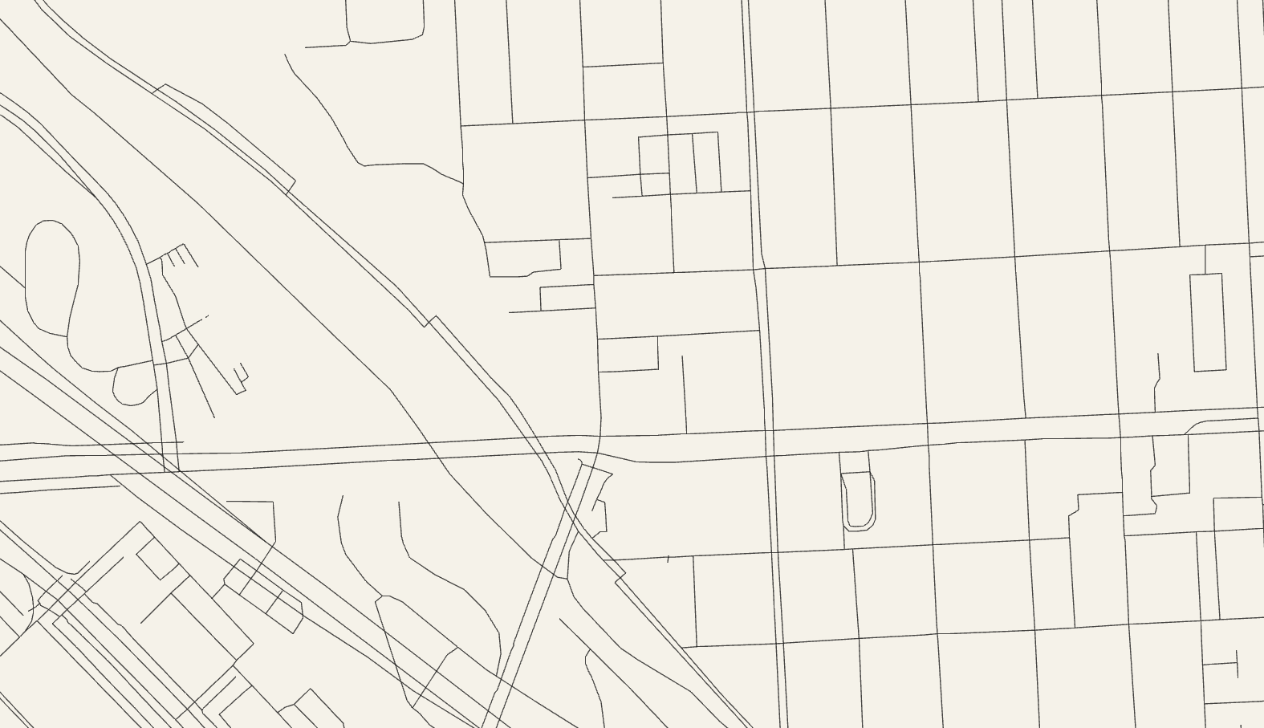
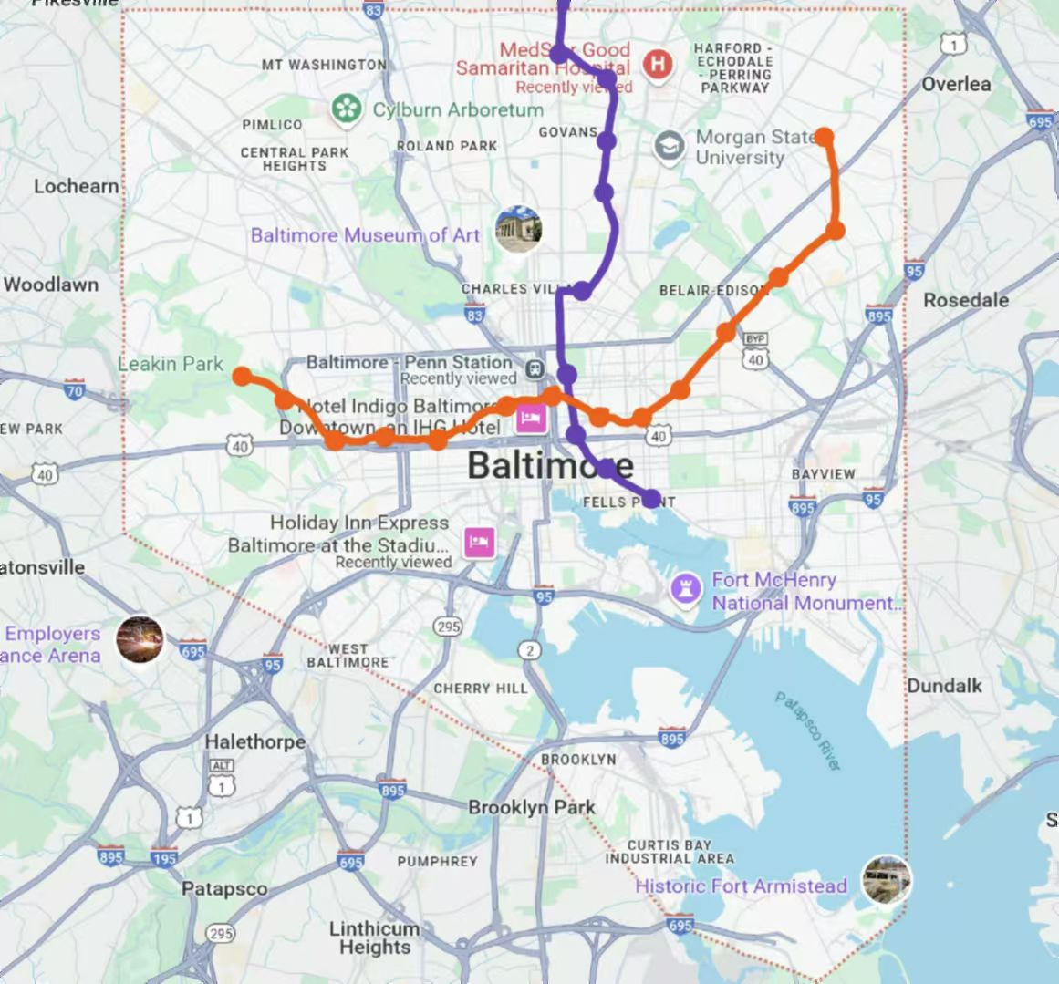
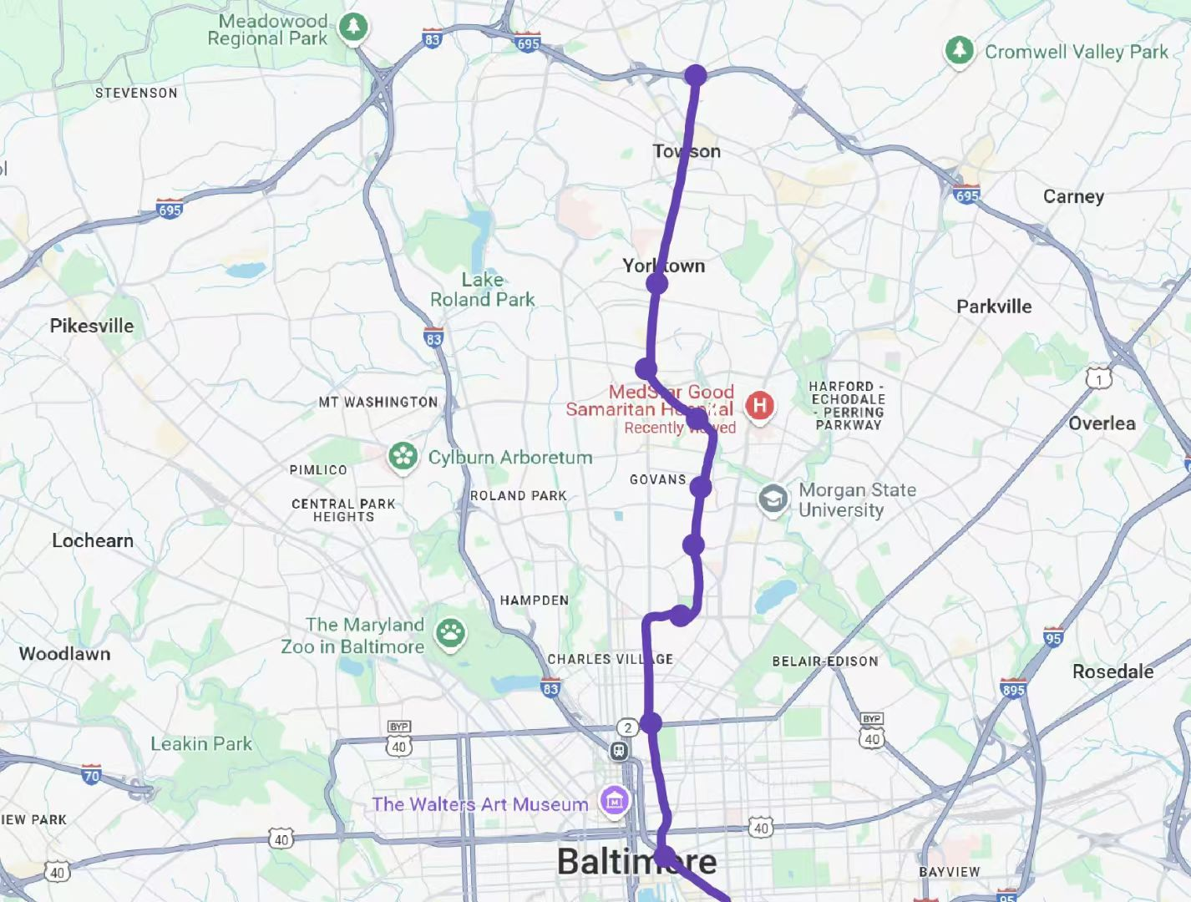
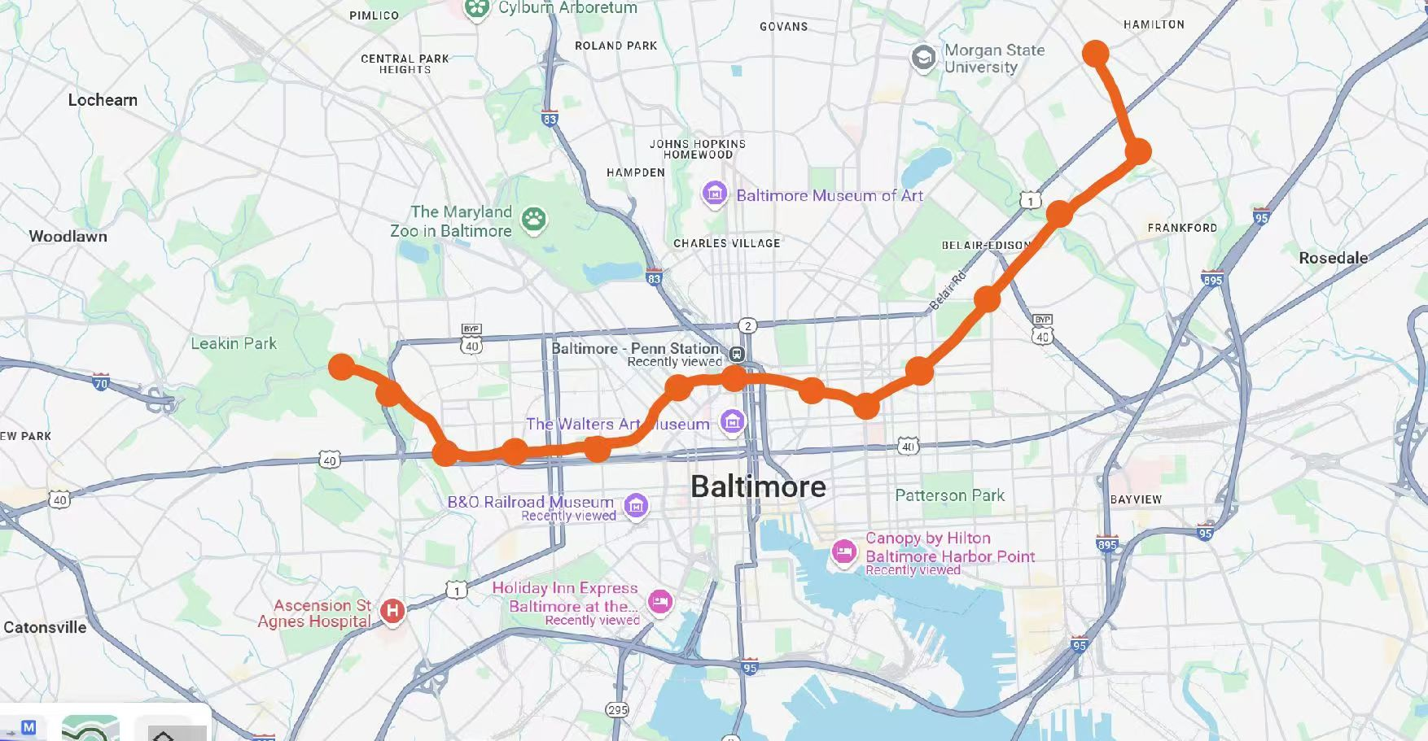
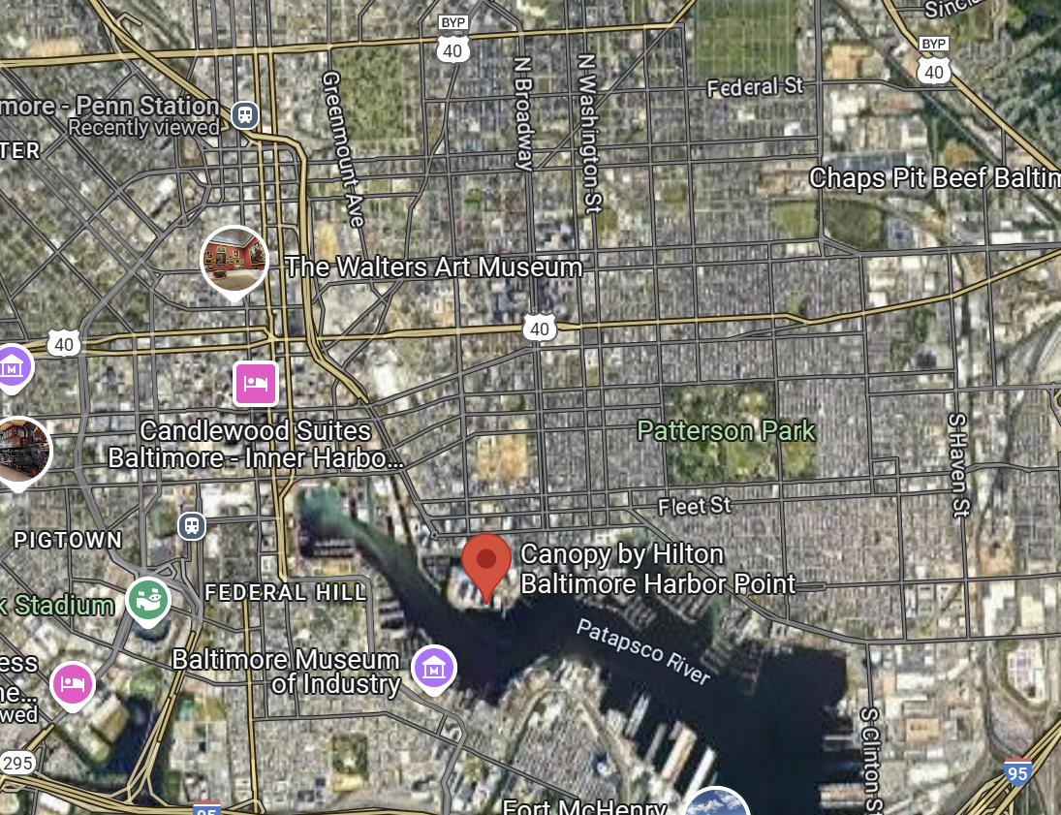
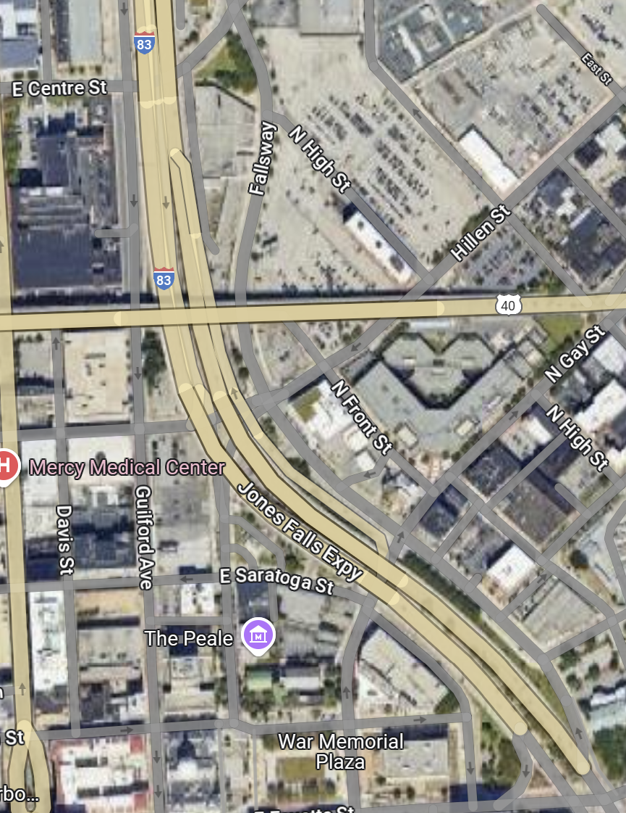
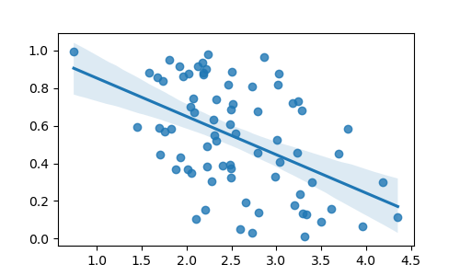
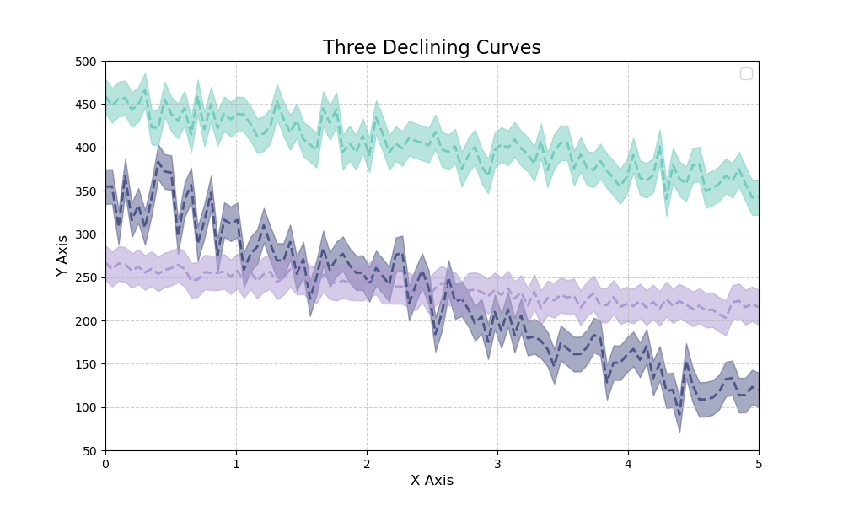
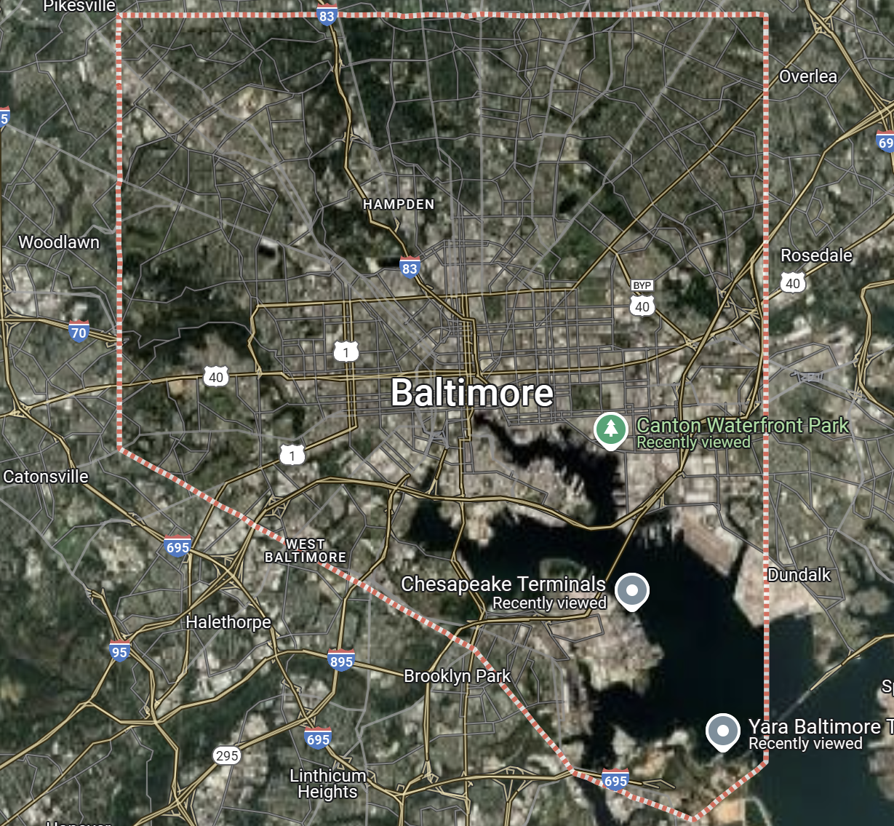
Area A
N
8km
4 mi
color
class
Area B
Area D
Suburb
This PPT is open-sourced by PadingPetals on GitHub. Commercial use is not permitted.
Periphery
Resident
Area E
Port
Baltimore
Sea
Area F
Port of Baltimore
path
needs
Area G
inbound need
resident need
Area H
industry need
Area C
Area I
Area G
Chesapeake Bay
pass need
Yara Baltimore Terminal
Area K
Pipline :
Everyone has his roads
Pathfinding Patterns for Pedestrian Flow Based on Optimal Experience
id
Xi
Yi
37020533
39.36
-76.46
Graph G = (N,P)
37020533
39.36
-76.46
N
The ground truth
…
…
…..
point abstraction process
Random rs and rt
u
path
v
P
Road Congestion
Min-max flow model
The collected data
edge abstraction process
b. Graph Theory Problems Solving
Minimizing Congestion Accumulation
c. Random Pairwise Sampling Model
a.Data processing
The satisfaction levels among residents
The number of bus stops in different areas
The First Problem
Result
The Second Problem
Result
The Second Problem
Result
Before
Suburb 1
enhance
Before
inbound
😒
inbound
🥰
inbound
😡
resident
😒
After
After
resident
🥰
resident
🥰
Suburb 2
industry
😡
industry
😊
industry
😊
Abstract diagram
pass
I-83 Issue
Crime Safety Issue
Suburb 3
😒
pass
😊
pass
😡
G = (N,P)
Traffic Plan Issue
Traffic Safety Issue
Suburb 4
Urban 1
Pedestrian Pathfinding
Road Congestion Formula
Urban 2
reduce
Constructed Two
East-West Arterial Road
Urban 3
Metro Planning
Demolition of I-83 and US 40 Highways
+
+
Bus-Metro Connections
Vx
Random Pairwise Sampling Model
+
Minimizing Congestion Accumulation
demolition
I-83
Traffic Flow Heatmap
Min-Max flow model
build
inbound
industry
resident
pass
Four Need
The Stakeholder Segmentation Model
US 40
Suburb
Resident
K Areas
Periphery
Port
Sensitivity analysis of random point pair sampling size 𝑡
Demolition and Reconstruction Section Plan
The relationship between crime rates and traffic flow
a. t = 700
b. t = 7000 (chosen)
c. t = 70000
Sensitivity of congestion index sampling threshold σ
a. Crime map of Baltimore
b. Traffic map of Baltimore
a.γ = 0.2
b. γ = 0.59 (chosen)
c. γ = 0.9
The traffic flow diagram for different plans
a. US40 road issue
b. I-83 road issue
Subway
New bus way
New bus stop
b. Metro plan
Subway station
a. No plan
c. Demolition and Reconstruction plan
dis(K,O) < λ
Comparison before and after the establishment of two subway lines
Removed bus stop
Bus and subway connection mechanism
Subway plan
Subway plan
a.The plan
b.Before
c.After
highway running through the city
a. North-south suburban subway
b. East-west urban subway
Industrial Demand Pairing Sampling and Regression Results
Trend Chart of Overall Type Demand Satisfaction and Bridge Connectivity
The Overall Pedestrian Flow Demand Satisfaction
The Pair Flow Demand Satisfaction
a.The Ground Truth
b. simulation heatmap evidence
a. simulation heatmap evidence
I. North-south suburban traffic issues
II. East-west urban traffic issues
resident need
pass need
industry need
The Ground Truth
a.Before
b.After
Traffic Congestion Statistics by Grid Division

Slide 2
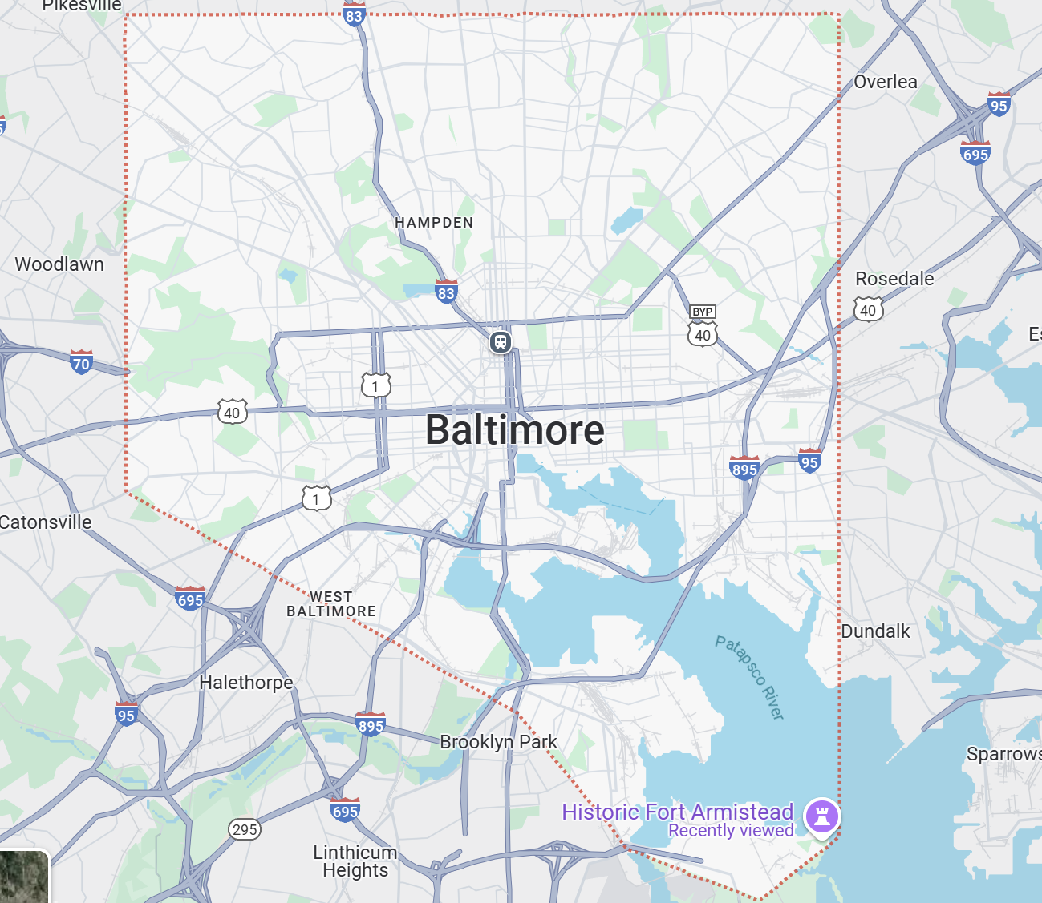

Slide 3
N
8km
4 mi
Baltimore
Port of Baltimore
Chesapeake Bay
Yara Baltimore Terminal

Slide 4
Area A
color
class
Area B
Area D
Suburb
Periphery
Resident
Area E
Port
Sea
Area F
path
needs
Area G
inbound need
resident need
Area H
industry need
Area C
Area I
Area G
pass need
Area K

Slide 5
Pipline :
Everyone has his roads
Pathfinding Patterns for Pedestrian Flow Based on Optimal Experience
id
Xi
Yi
37020533
39.36
-76.46
Graph G = (N,P)
37020533
39.36
-76.46
N
The ground truth
…
…
…..
point abstraction process
Random rs and rt
u
path
v
P
Road Congestion
Min-max flow model
The collected data
edge abstraction process
b. Graph Theory Problems Solving
Minimizing Congestion Accumulation
c. Random Pairwise Sampling Model
a.Data processing

Slide 6
Baltimore
…
Maryland
University
…
Inner Harbor
…
…
Baltimore Penn Station
…
The nodes
landmark building
…
Fells Point

Slide 7
The Ground Truth
a.Before
b.After
Traffic Congestion Statistics by Grid Division

Slide 8
Trend Chart of Overall Type Demand Satisfaction and Bridge Connectivity
The Overall Pedestrian Flow Demand Satisfaction
resident need
pass need
industry need

Slide 9
Industrial Demand Pairing Sampling and Regression Results
The Pair Flow Demand Satisfaction

Slide 10
highway running through the city
a.The Ground Truth
b. simulation heatmap evidence
a. simulation heatmap evidence
I. North-south suburban traffic issues
II. East-west urban traffic issues

Slide 11
Subway plan
Subway plan
a. North-south suburban subway
b. East-west urban subway

Slide 12
Comparison before and after the establishment of two subway lines
a.The plan
b.Before
c.After

Slide 13
The number of bus stops in different areas
Suburb 1
enhance
Before
After
Suburb 2
Suburb 3
Suburb 4
Urban 1
Urban 2
reduce
Urban 3
Vx

Slide 14
Subway
New bus way
New bus stop
Subway station
dis(K,O) < λ
Removed bus stop
Bus and subway connection mechanism

Slide 15
a. US40 road issue
b. I-83 road issue

Slide 16
The relationship between crime rates and traffic flow
a. Crime map of Baltimore
b. Traffic map of Baltimore

Slide 17
demolition
I-83
build
US 40
Demolition and Reconstruction Section Plan

Slide 18
The traffic flow diagram for different plans
b. Metro plan
a. No plan
c. Demolition and Reconstruction plan

Slide 19
The satisfaction levels among residents
Before
After

Slide 20
Sensitivity analysis of random point pair sampling size 𝑡
a. t = 700
b. t = 7000 (chosen)
c. t = 70000
Sensitivity of congestion index sampling threshold σ
a.γ = 0.2
b. γ = 0.59 (chosen)
c. γ = 0.9

Slide 21
The First Problem
Result
The Second Problem
Result
The Second Problem
Result
inbound
😒
inbound
🥰
inbound
😡
resident
😒
resident
🥰
resident
🥰
industry
😡
industry
😊
industry
😊
Abstract diagram
pass
I-83 Issue
Crime Safety Issue
😒
pass
😊
pass
😡
G = (N,P)
Traffic Plan Issue
Traffic Safety Issue
Pedestrian Pathfinding
Road Congestion Formula
Constructed Two
East-West Arterial Road
Metro Planning
Demolition of I-83 and US 40 Highways
+
+
Bus-Metro Connections
Random Pairwise Sampling Model
+
Minimizing Congestion Accumulation
Traffic Flow Heatmap
Min-Max flow model
inbound
industry
resident
pass
Four Need
The Stakeholder Segmentation Model
Suburb
Resident
K Areas
Periphery
Port

